Slide 1
Romeo BLE Motor Control

Slide 2
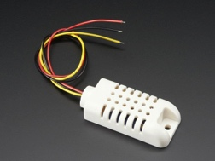
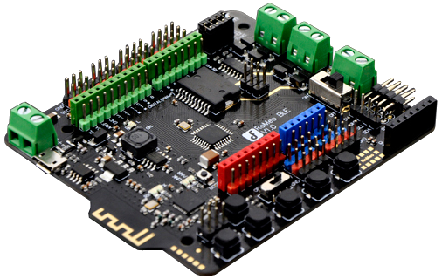
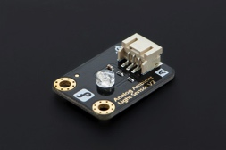
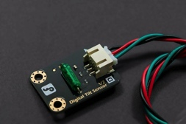
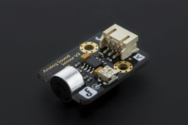
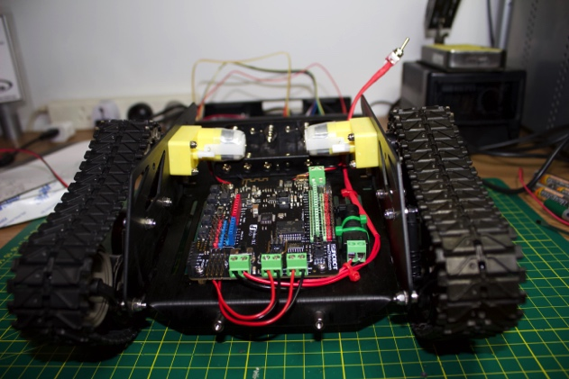
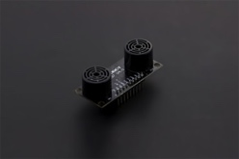
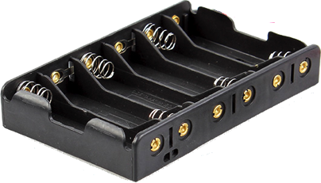
System Architecture – Stage 1
Sensors
Micro Controller
Remote
Power
Motor Control

Slide 3
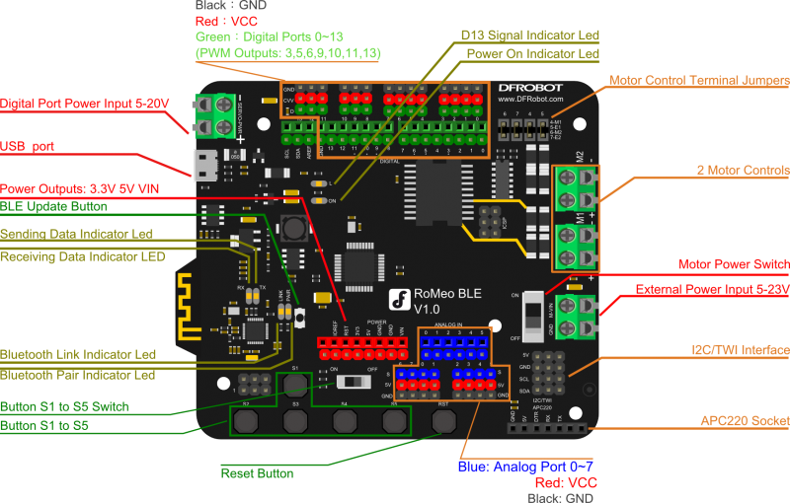
Romeo BLE

Slide 4
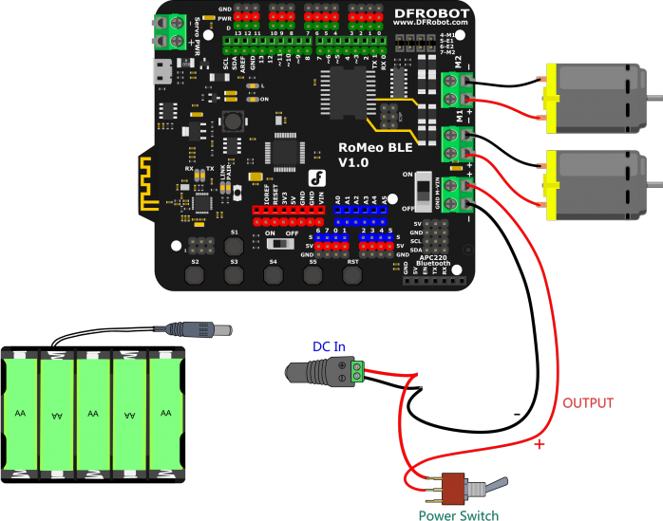
Tank Wiring Diagram

Slide 5
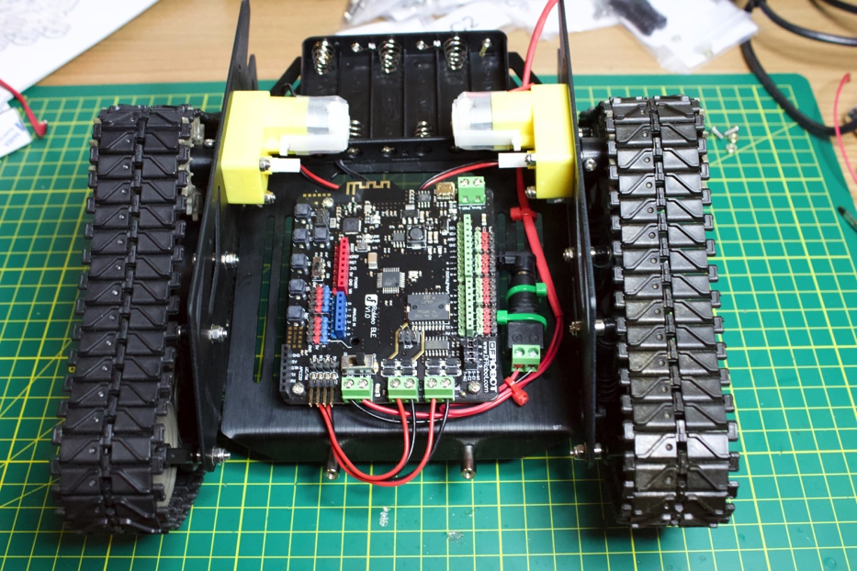
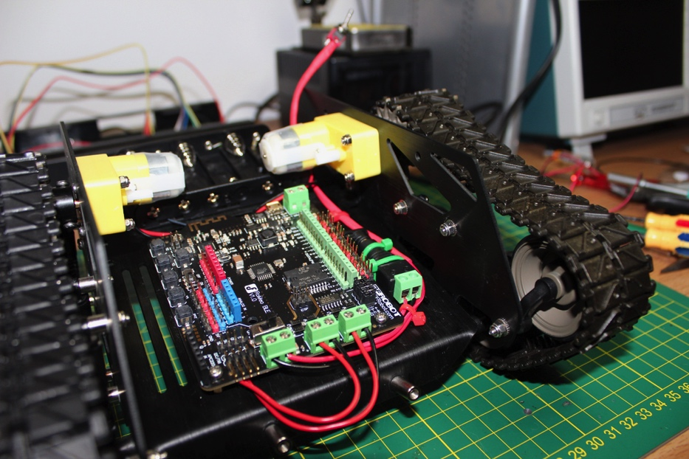
Construction Tips
Don’t attach the velcro to the battery holder yet – you can’t insert the programming cable when the battery holder is mounted.
It is a good idea to use the switch even if you don’t have rechargeable batteries – otherwise you can’t turn off power without removing the lid. You will need a soldering iron.

Slide 6
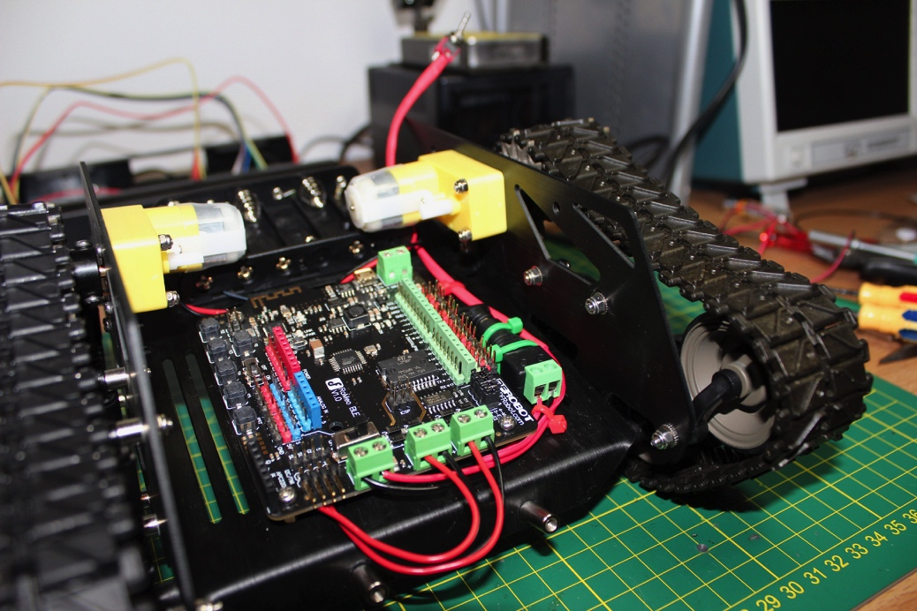
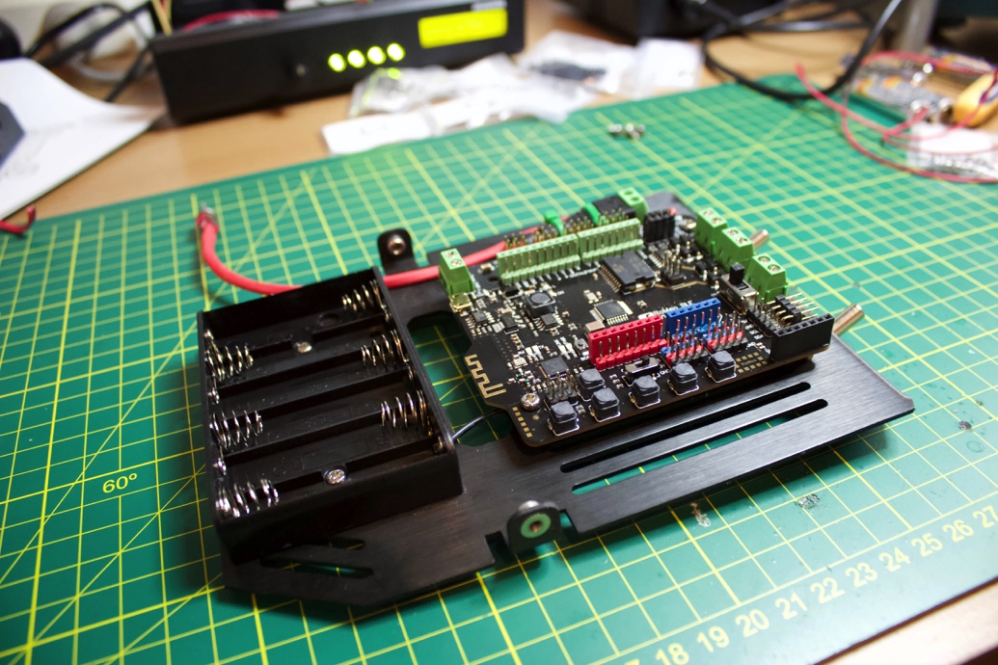
Control Options
Wired:
Digital Inputs
Serial Monitor
Hardware Buttons
Bluetooth:
Keyboard
Laptop
Mobile Phone

Slide 7
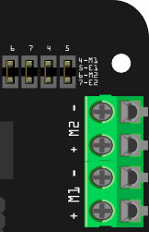
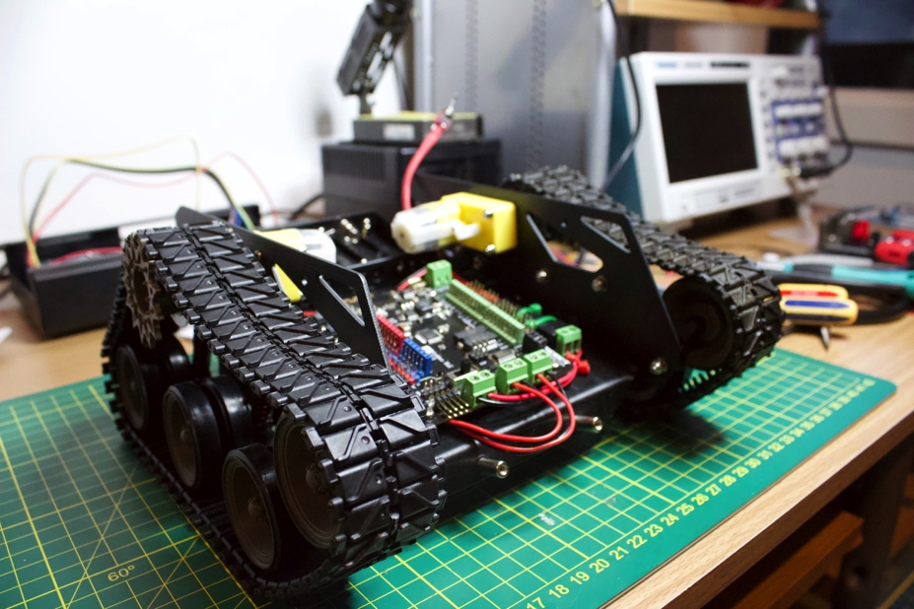
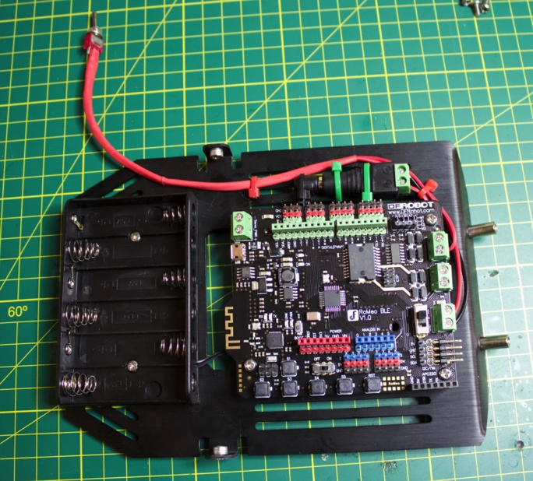
Romeo Pin Allocations
Pin | Function
D4 | Motor 1 Direction
D5 | Motor 1 Speed - PWM
D6 | Motor 2 Speed - PWM
D7 | Motor 2 Direction

Slide 8
Motor Control with Romeo
For each motor you control direction and speed.
M1 = right motor, M2 = left motor.
Jumpers connect pins 4,5,6,7 to M1 and M2 terminals.
Direction Pin: HIGH = Forward, LOW = Back.
Speed Pin: PWM – duty cycle from 0 (0% = off) to 255 (100% = full speed). Need DI pins with PWM.
PWM on pins 5 and 6 can have higher-than-expected duty cycles. Due to interaction between millis(), delay() functions and PWM, which all use the same internal timer.
5V
PWM Signal
On-time
Off-
time

Slide 9
Control via Serial Monitor
Turn off the battery switch and motor switch.
Connect PC to the Romeo USB port.
Upload the SerialControl.ino sketch.
Start the Serial Monitor (115,200 baud, no line ending).
Turn on battery switch and motor switch.
For the first test have the tracks off the ground – the tank is pretty quick!
Valid Commands are: w = forward, a = left, s = back, d = right, t = test message, x = stop.

Slide 10
Control via Bluetooth (BLE) App
Turn off the battery switch and motor switch.
Connect PC to the Romeo USB port.
Upload the BluetoothControl.ino sketch.
Turn on battery switch and motor switch.
Download App to your mobile:
iOS - AVA BLE Remote - https://itunes.apple.com/au/app/ava-ble-remote/id1073023233?mt=8
Android - https://github.com/DFRobot/BlunoBasicDemo/tree/master/Android
Open the app and connect to the robot.
AVA BLE Valid Commands are: f = forward, l = left, b = back, r = right, t = test message, s = stop.
Notes:
Android Version - https://github.com/DFRobot/BlunoBasicDemo/tree/master/Android

Slide 11
Appendix A – Using AVA BLE Remote

Slide 12
AVA BLE
To connect to a device just tap on its name.
Manual search for BLE devices by tapping the search icon in the top right.
Disconnect device button (a cross) is at the top left.
You can only attach to one BLE device at a time.

Slide 13
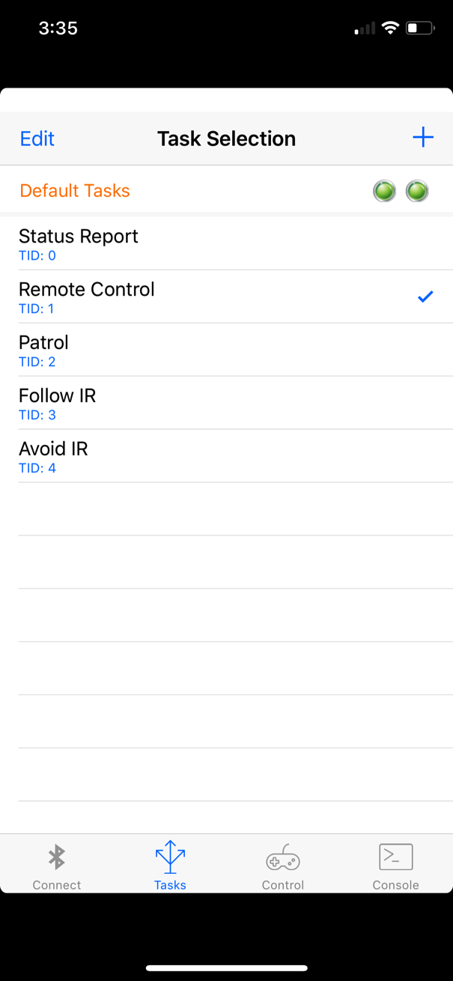
AVA BLE
The Task tab allows you to send a tasking message to your robot.
Tapping a task will transmit the tasking ID (e.g. 1) via Bluetooth.
Tap the add button (+) to add your own tasks.
Tap Edit to delete or rearrange the tasks.
Tapping "Default Tasks" will reload the task list that comes with the app.

Slide 14
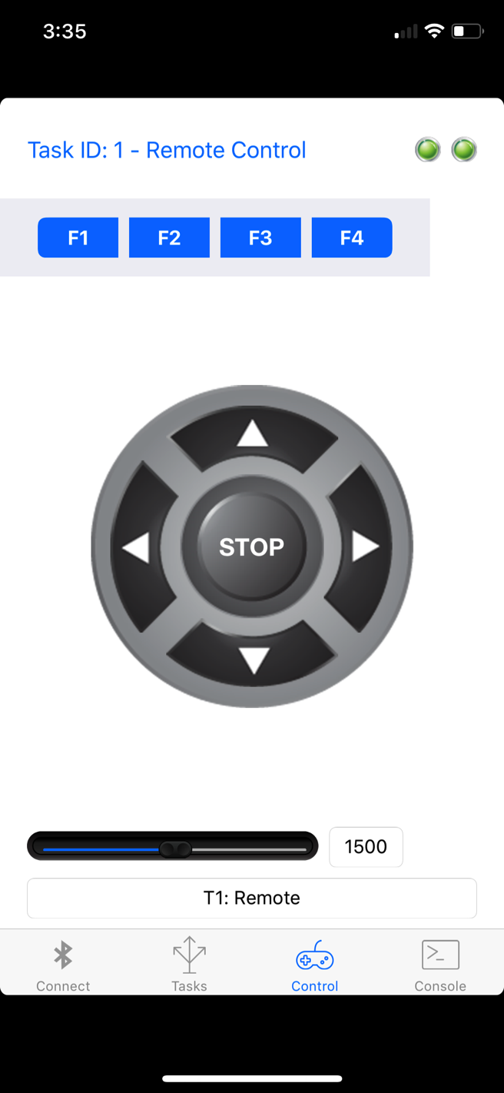
AVA BLE
The Control tab acts as a virtual gamepad for your BLE device.
The currently selected task is displayed at the top of the screen.
Tapping the function keys (F1 to F4) will send the designated character via Bluetooth to your Robot.
Similarly, tapping the directional dPad or stop button will send the character assigned to those buttons.
You can change the characters which are transmitted from the key mapping option in the console tab.

Slide 15
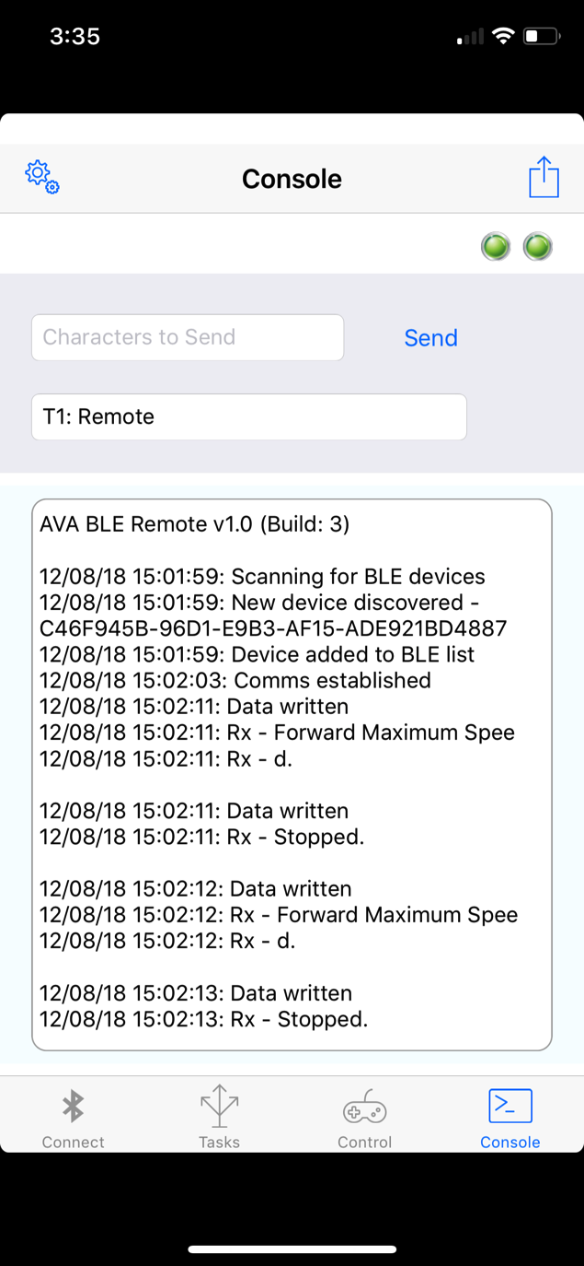
AVA BLE
The console tab allows you to send any character strings that you wish to the Robot.
Type the message in the text field and tap Send. Any received messages will be displayed below.
Tap the settings (gear icon) button if you wish to change the keys mapped to the Control buttons.

